Slide 1

SMART WATCH
SUBMITTED BY:
VINAY BALAMURALI - 63
SRINIVAS PRABHU – 56
RUTHVIK SJ -44
AISIRI H R – 04

Slide 2
ABSTRACT
In recent technological innovations in the field of disease prevention and maintenance of patient health have enabled the evolution of fields such as monitoring systems. Heart rate is a very vital health parameter that is directly related to the soundness of the human cardiovascular system.
It can be measured either by the ECG waveform or by sensing the pulse - the rhythmic expansion and contraction of an artery as blood is forced through it by the regular contractions of the heart. The pulse can be felt from those areas where the artery is close to the skin.
In this project we have built a smart watch which can monitor and keep track of the heart beat of the user. The pulse is sensed by the artery lying underneath and is displayed on OLED interfaced with it whenever touched.

Slide 3
HEART RATE AND HEART RATE MONITORING
Heart rate (HR) or pulse rate represents the number of times a heart beats each minute. The determination of what a normal heart rate is depends on many factors, such as age, body size, movement, exercise, and heart conditions. A normal heart rate can be between 70 and 100 beats per minute (bpm).
A heartrate monitor is a personal monitoring device that allows one to measure/display heart rate in real time or record the heart rate for later study. It is largely used to gather heart rate data while performing various types of physical exercise.

Slide 4
APPLICATIONS
Healthcare applications
Monitoring health of the elderly
Monitoring Exercise Intensity
Preventing Overtraining
Estimation of Maximal oxygen uptake (VOmax) and EE (Energy-Expenditure)

Slide 5
LITRATURE SURVEY
TITLE OF PAPER | APPLICATION | APPROACH | SENSING METHOD
The use of smart watches to monitor heart rates in elderly people: A Complimentary approach | A knowledge based system to call for help during abnormal heart rates in elderly. | Through rule based reasoning . | No information given
Multi parameter health monitor watch | To build a watch to monitor multiple parameters to tackle chronic non communicable disease. | Continues monitoring of data from sensor. | Dry electrode in front of the watch . Reflective method for acquiring PPG signals.
Smart wrist watch | Building a data base of health parameters of an individual. | Continues monitoring and storage of data from sensors. | BMR is calculated by Harris Benedict equation. TMP75 for temp measurement.
Heart Rate Data Collection Using Smart Watch | Heart rate data collection using a built smart watch for future use in diagnosis | Data collection from already built smart watch. | ----

Slide 6
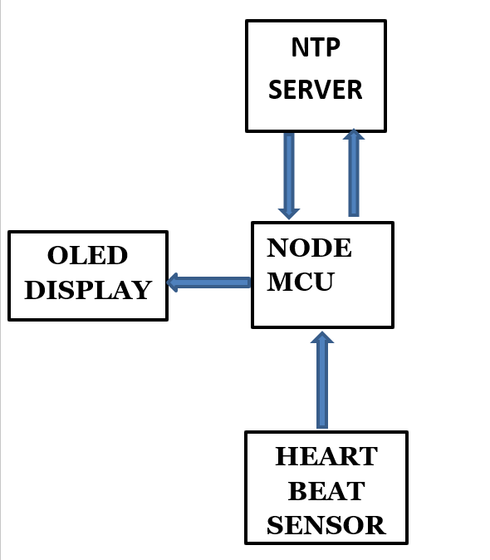
Block diagram

Slide 7
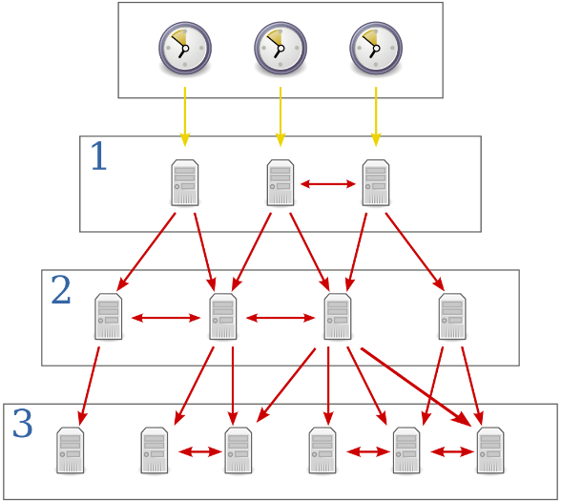
NTP SERVER
NTP stands for Network Time Protocol, and it is an Internet protocol used to synchronize the clocks of computers to sometime reference.
NTP uses a hierarchical, semi-layered system of time sources. Each level of this hierarchy is termed a stratum and is assigned a number starting with zero for the reference clock at the top.
Yellow arrows indicate a direct connection; red arrows indicate a network connection

Slide 8
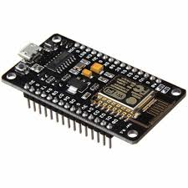
NODE MCU
NodeMCU is an open source Lua based firmware for the ESP8266 WiFi SOC from Espressif and uses an on-module flash based SPIFFS file system

Slide 9
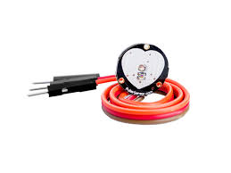
Heart Beat Sensor
A heart rate monitor (HRM) is a personal monitoring device that allows one to measure/display heart rate in real time or record the heart rate for later study. It is largely used to gather heart rate data while performing various types of physical exercise.

Slide 10
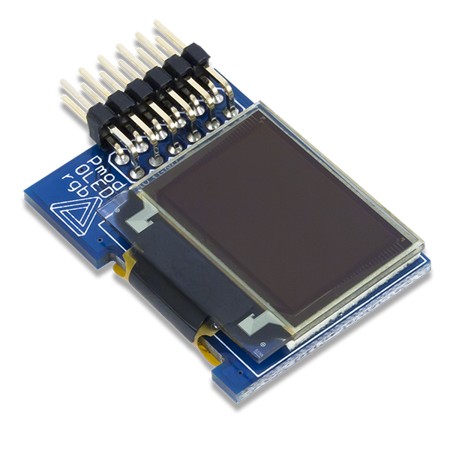
OLED
An organic light-emitting diode (OLED) is a light-emitting diode (LED) in which the emissive electroluminescent layer is a film of organic compound that emits light in response to an electric current. This organic layer is situated between two electrodes; typically, at least one of these electrodes is transparent. OLEDs are used to create digital displays in devices such as television screens, computer monitors, portable systems such as smartphones, handheld game consoles and PDAs.

Slide 11
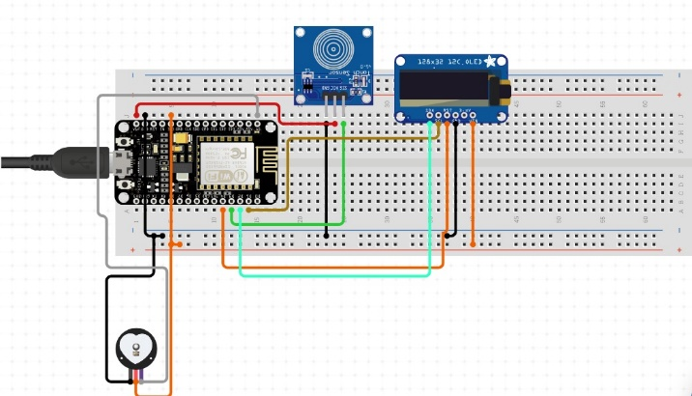
CIRCUIT DIAGRAM AND WORKING

Slide 12
NODE MCU CODE

Slide 15
VERILOG CODE

Slide 18
RELEVENCE
SENSORS AND INSTRUMENTATION:
Interfacing sensor with other modules to build application based project .
Reading and displaying of data from heart sensor to continuously monitor heart rate.
MICROCONTROLLER:
Application of concepts learnt in the subject to code NodeMCU.
DIGITAL SIGNAL DESIGN :
Verilog code for the application is built and tested

Slide 19
REFERNCE
[1] Majid H. Alsulami, Anthony S. Atkins, Russell J Campion
(2016), The Use of Smart Watches to Monitor Heart Rates in Elderly People: A Complementary Approach.
[2] Lipeng Fang Xianxiang Chen , Zhen Fang, Kai Tong , Jiankang Liu Zhengling He, Junxia LiMulti, “parameter health monitoring watch”. 2017 IEEE 19th International Conference on e-Health Networking, Applications and Services
[3] Najuka Jagtap, Jagannath Wadgaonkar, Kalyani Bhole , Smart Wrist Watch, 2016 IEEE Students’ Conference on Electrical, Electronics and Computer Science
[4] H. Mansor, M. H. A. Shukor, S. S. Meskam, N. Q. A. M. Rusli, and N. S. Zamery, “Body temperature measurement for remote health monitoring system,” in Smart Instrumentation, Measurement and Applications (ICSIMA), 2013 IEEE International Conference on, pp. 1–5, IEEE, 2013.

